Slide 1
Searching

Slide 2
Searching
Searching refers to the operation of finding an item from a list of items
based on some key value.
Two Searching Methods
Linear Search
Binary Search

Slide 3
Linear Search
A linear search is a technique for finding a particular value in a unsorted or sorted list.
Search each item of list using key value, one at a time, until finding the item
from the list.
Algorithm: Linear-Search (L, N, Key)
Set k := 0 and Loc := Null
Repeat Steps 3 and 4 while k <= N
If Key = L[k], then Set Loc := k, print: Loc and exit.
Set k := k+1
If Loc = Null then Write: Item is not in List
Exit
Here
L - The list of data items
N – Total no. of items in L
Key – Item to be searched.
Define Null = -1

Slide 4
Example of Linear Search
List : 10, 6, 222, 44, 55, 77, 24
Key: 55
Steps:
6 222 44 55 77 24 K=1
10 222 44 55 77 24 K=2
10 6 44 55 77 24 K=3
10 6 222 55 77 24 K=4
10 6 222 44 77 24 K=5
So, Item 55 is in position 5.
55
10
55
6
55
222
55
44
55
55

Slide 5
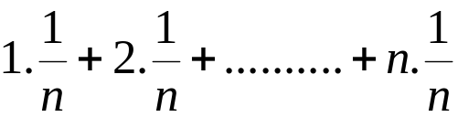
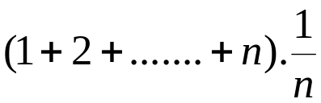
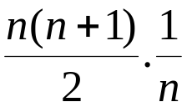
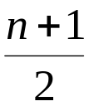
Complexity Analysis of Linear Search
Worst Case
The worst case occurs when Item is the last element in the List or is not in
the List.
So, C(n) = n = Θ(n).
(2) Average Case
The average case occurs when the availability of the Item in the List is
equally likely to occur at any position in the List.
So, C(n) =
=
=
=
= 0(n)

Slide 6
Binary Search
List of items should be sorted.
It uses the divide-and-conquer technique.
The elements of the list are not necessarily all unique. If one searches for a value that occurs multiple times in the list, the index returned by the binary search will be of the first-encountered equal element.
Compare the given Key value with the element in the middle of the list. It tells which half of the list contains the Item.Then compare Key with the element in the middle of the correct half to determine which quarter of the list contains Item. Continue the process until finding Item in the list.

Slide 7
Algorithm: Binary-Search (L, N, Key)
Set Loc := Null, Beg := 0, End :=N-1 and Mid := (Beg + End)/2
Repeat steps 3 and 6 while Beg <= End
If Key < L[Mid], then Set End := Mid – 1
Else if Key>L[Mid] then Set Beg := Mid + 1
Else if Key = List[Mid] then Loc:= Key, print: Loc and exit.
Set Mid := (Beg + End)/2
If Loc = Null Write: Item is not in List.
Exit.
Here
L - The list of data items
N – Total no. of items in L
Key – Item to be searched.
Define Null = -1

Slide 8
Example of Binary Search
List : 6, 10, 20, 30, 55, 75, 190
Key: 55
Steps:
6 10 20 55 75 190 Beg=1, End=7,Mid=4
6 10 20 30 55 190 Beg=5, End=7,Mid=6
6 10 20 30 75 190 Beg=5, End=5,Mid=5
[Item Found]
So, Item 55 is in position 5.
55
30
55
75
55
55

Slide 9
Complexity of Binary Search
The complexity of binary search is measured by the number of comparisons to locate Item in List where List contains n elements. It is observed that each comparison reduces the sample size in half.
So, C(n) = n + n/2 + n/4+…………..+1 = log₂n+1 = 0(log₂n)

